Slide 1

Bank Marketing Effectiveness
Capstone project on:
Presented by:
Subhadip Ghosh

Slide 2
Journey Roadmap:
Problem Statement
Discussing our dataset
Basic Data Inspection
Exploratory Data Analysis
Conclusions from EDA
Feature Engineering
Feature Selection
Handling Imbalance of our Response Variable
Fitting and Evaluating our model
Discussing metrics for imbalanced classification problems
Conclusion

Slide 3
Problem Statement:
Our dataset is related with direct marketing campaigns of a Portuguese banking institution. The marketing campaign were based on phone calls. The product of the banking institution is 'Bank Term Deposit'. Our response feature is named 'subscribed' and it has two class labels:
Yes: meaning the client has subscribed
No: meaning the client has not subscribed to the product
We have modified our class labels to 0 and 1 corresponding to 'No' and 'Yes' respectively.
Our aim of this model is to predict the 'subscribed' column to predict whether a client will subscribe to the 'Bank Term Deposit' or not.

Slide 4
Discussing our dataset:
Our dataset has 45211 records, and we have 15 features which determines our response variable 'Subscribed'.
Discussing some of our features which are quite hard to interpret:
Month,Day : Corresponding Date when the customer was last contacted
Campaign: Number of times the client has been called for selling the product during this campaign.
Pdays: Number of days that have passed by after the client was last contacted.
previous: number of times the client has been called before this campaign.
poutcome: outcome of the previous marketing campaign

Slide 5
Basic Data Inspection:
Our dataset did not have any null values
Our response variable is heavily imbalanced. That is the number of clients who have subscribed to the 'Bank Term Deposit' are much lesser in counts than those who haven’t.
Some features like ‘pdays’ have very less variance, we will be inspecting these features in the further slides.
For the ease of understanding our features through Exploratory Data Analysis(EDA) we divided our features into:
Categorical Features
Numerical Features
Continuous Features
Discrete Features

Slide 6
Exploratory Data Analysis
EDA (Continuous and Discrete Features)
EDA (Categorical Features)

Slide 7
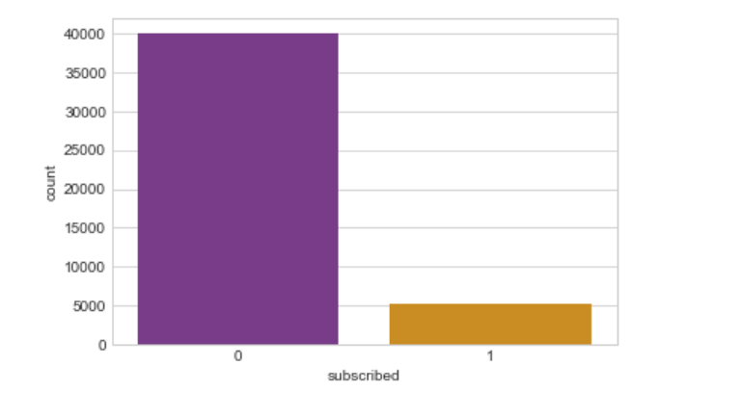
Exploratory Data Analysis(EDA):
Counts of our class labels
0 : Not Subscribed
1 : Subscribed
Conclusion:
Our response variable is heavily 'imbalanced' with almost 40000 clients corresponding to label 0, meaning they haven't ‘subscribed' and only a little over 5000 clients have subscribed to the ‘Bank Term Deposit’

Slide 8
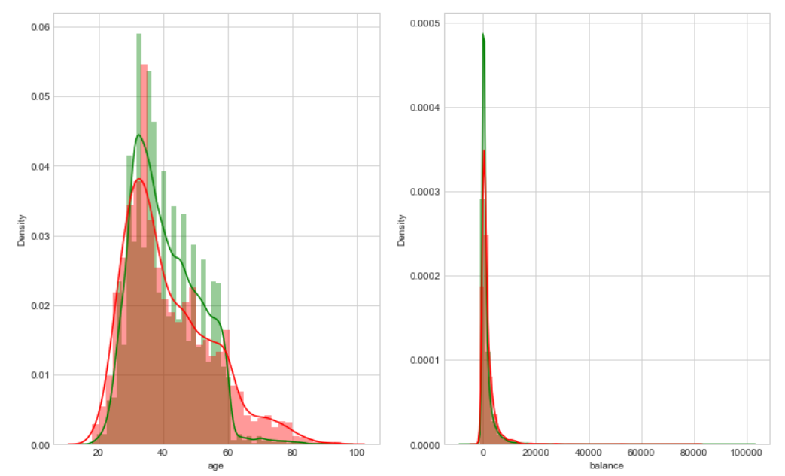
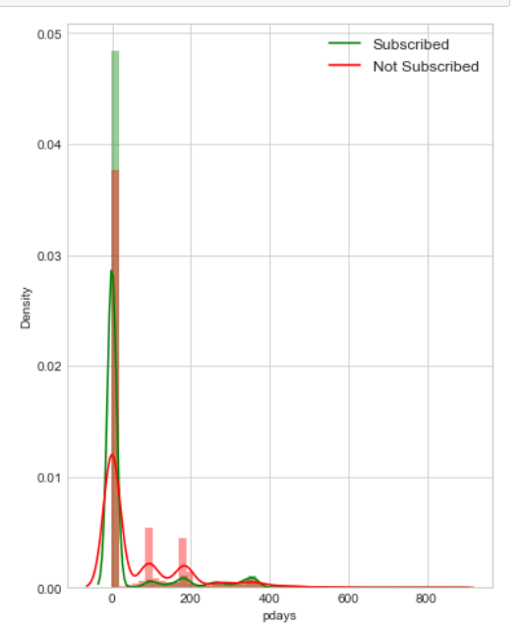
Exploratory Data Analysis(EDA):
Numerical Features (Continuous)
Distribution Plot
Not Subscribed
Subscribed

Slide 9
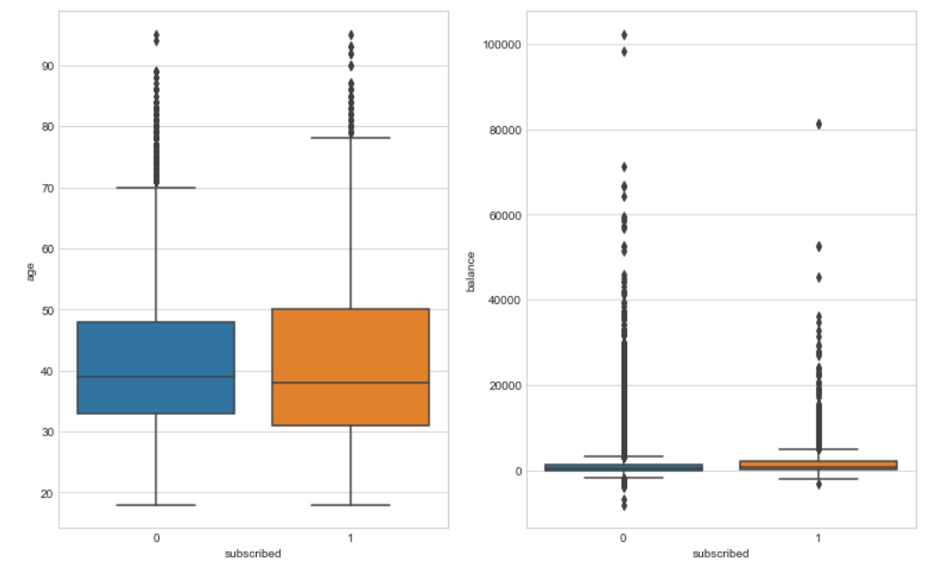
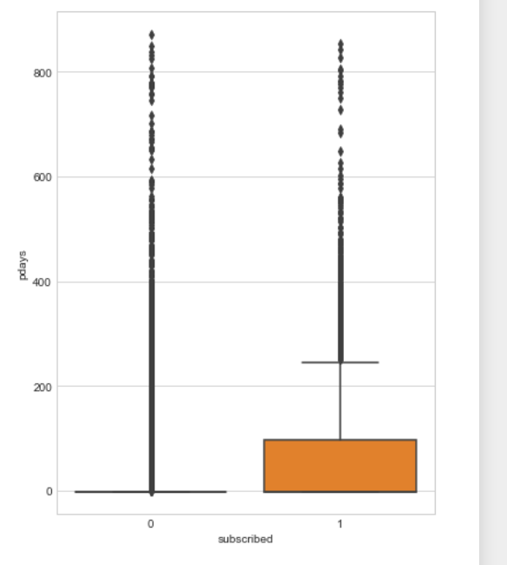
Exploratory Data Analysis(EDA):
Numeric Features (Continuous)
Boxplot Distribution

Slide 10
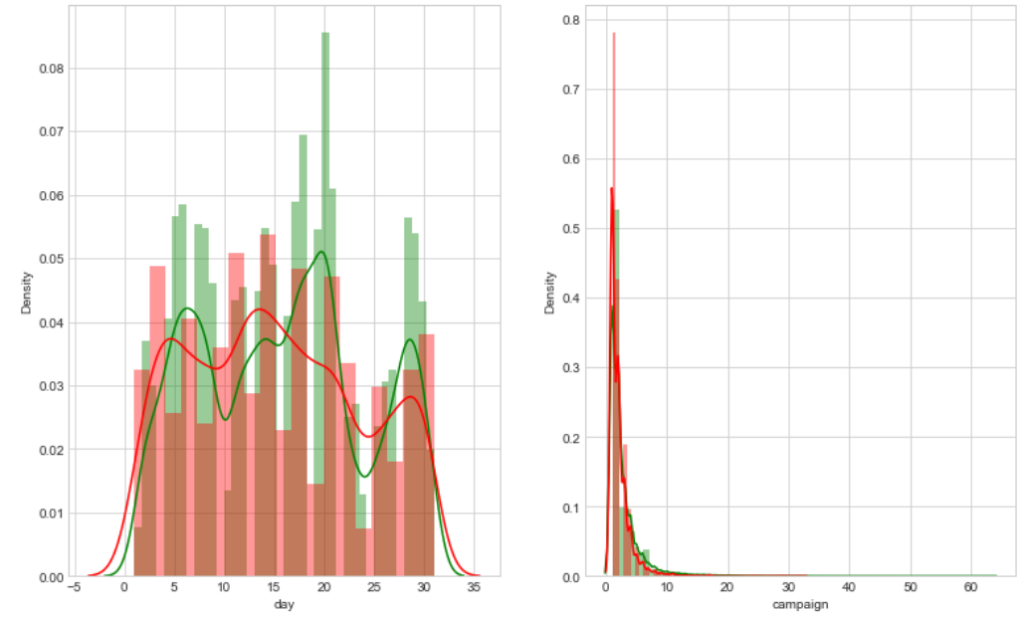
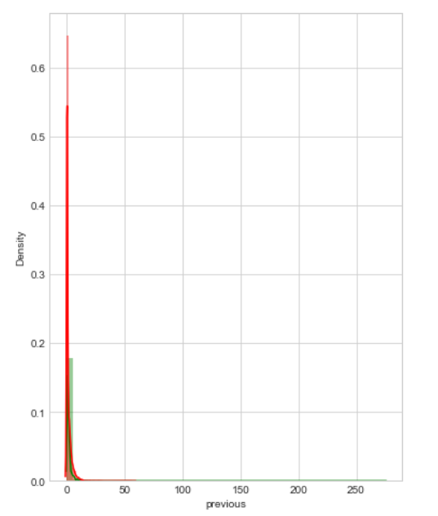
Exploratory Data Analysis(EDA):
Numerical Features(Discrete)
Distribution Plot
Not Subscribed
Subscribed

Slide 11
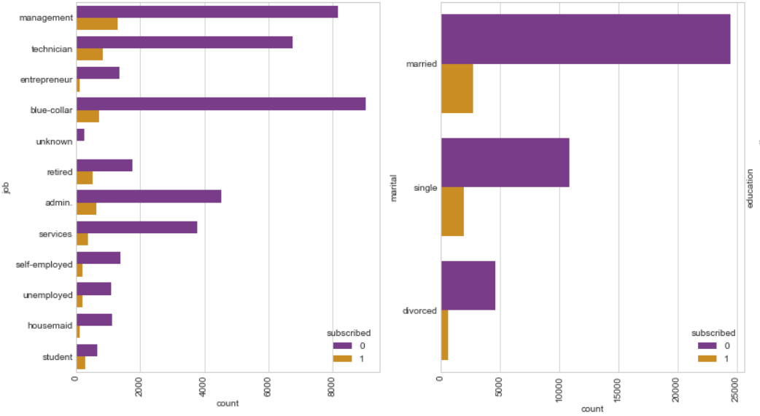
Exploratory Data Analysis(EDA):
Numerical Features(Discrete)
Countplot

Slide 12
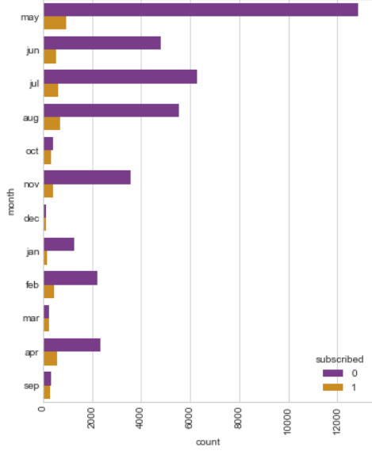
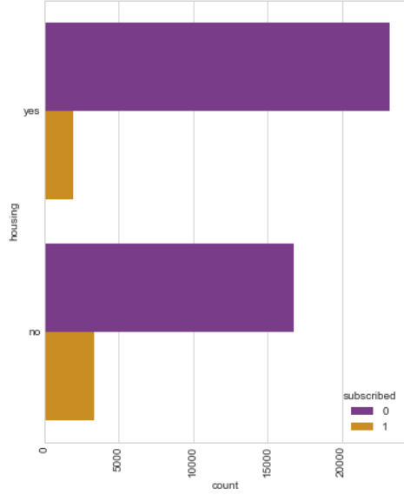
Exploratory Data Analysis(EDA):
Categorical Features
Countplot

Slide 13
Some questions still needs to be answered!!
Let’s take a look at some of the questions that still need more research:
Which job sector have the banks targeted the most in order to have better number of subscriptions?
What are the average ages of clients who have subscribed the most?
Why is our feature ‘pdays’ having abnormal distributions in our dataset? Is it even a continuous feature?
What is the success rate of the marketing campaign corresponding to each job sector?

Slide 14
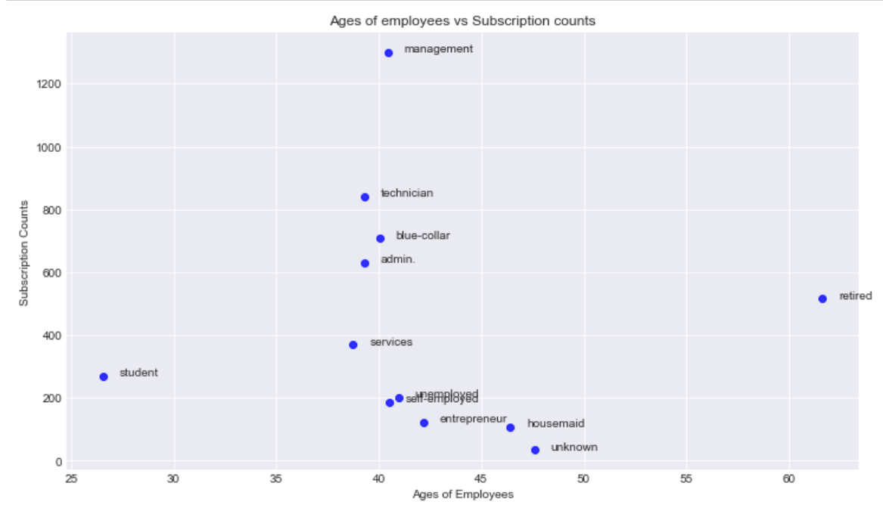
Exploratory Data Analysis (EDA): The number of subscriptions by clients of each job sector and their average ages:

Slide 15
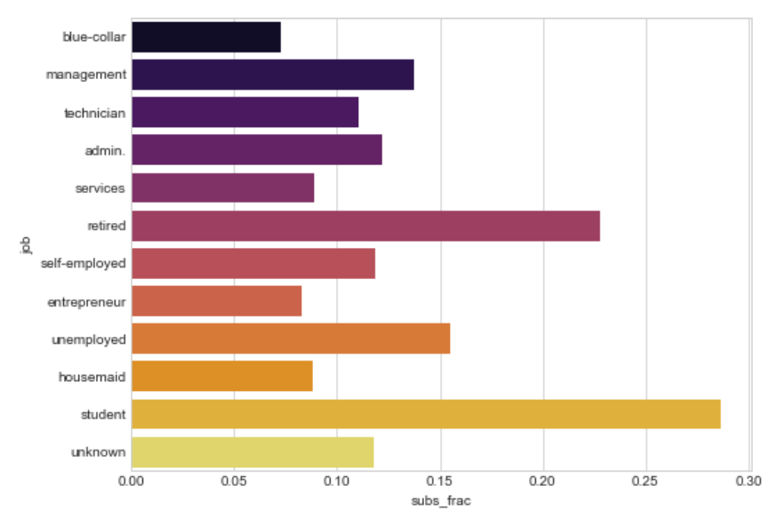
Exploratory Data Analysis (EDA): Success Rate of subscriptions corresponding to clients from each job sector

Slide 16
Feature Engineering Section:
Fixing Irregularities in features
Encoding our categorical features
(One hot encode, label encode, target encode)
Checking Statistical Significance of features
(Using Chi-Square Test)
Outlier Treatment

Slide 17
Fixing irregularities of certain features:
As we noticed in the distribution plots, the features ‘campaign’, ‘pdays’ and ‘previous’ along with some categorical features showed properties of abnormal distribution.
We would be operating on these columns by grouping all the values which contribute to less than 1 percent of our total number of samples, and then putting them in one value naming it 'Rare value’. We would do the same for the feature ‘Month’ as well.

Slide 18
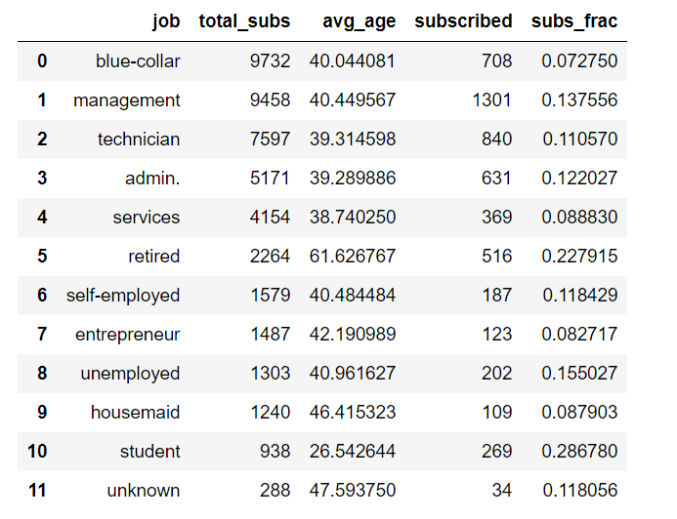
Target Encoding on ‘Job’ Feature:
Giving a sample of how we have target encoded features:
We have calculated the total number of times clients from each profession has been contacted and stored it in ‘total_subs’ column.
Calculated the number of times clients from each profession have subscribed and stored in ‘subscribed’ column.
Calculated the success ratio and stored in ‘subs_frac’ column
Subscribed
Success Ratio =
Total_subs

Slide 19
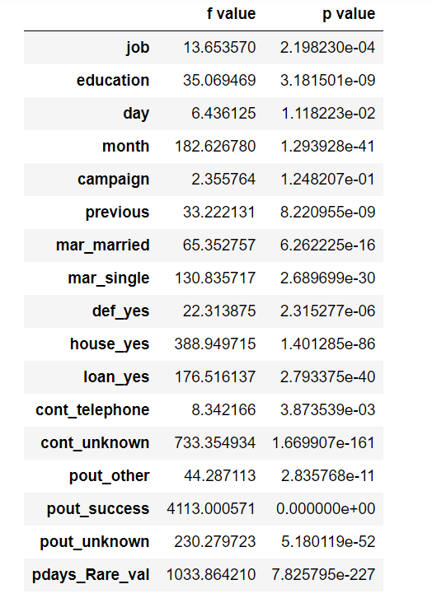
Checking Statistical Significance of discrete features using Chi-Square Test:
We imported ‘chi2’ from the scikit learn library.
‘Chi2’ returns two values for each feature with respect to the response feature. Those are the ‘f-values’ and ‘p-values’ respectively.
Null Hypothesis and Alternate Hypotheis Assumption:
Null Hypothesis(Ho) assumes there’s no relation between the features and the response feature ‘subscribed’.
Alternate Hypothesis(Ha) assumes that the relation between the features and the response feature is statistically significant.
We will reject the null hypothesis if p-value of a feature is less than alpha (0.05).

Slide 20
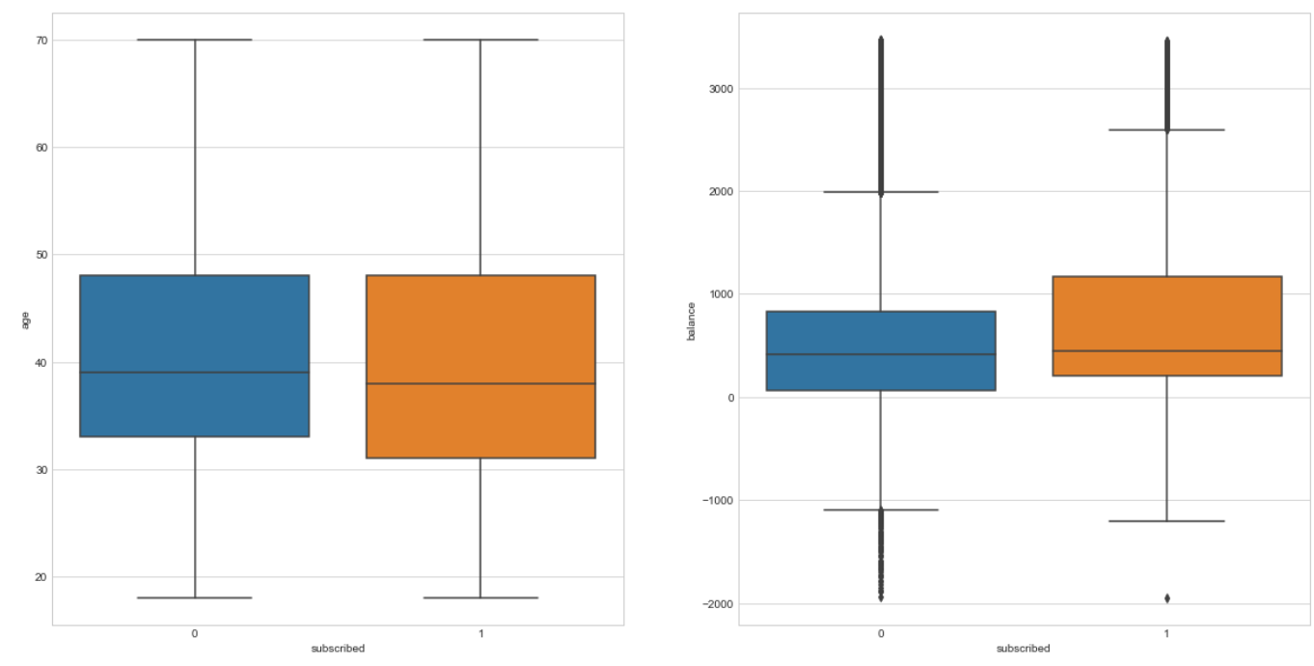
Outliers Treatment:
Used the IQR (Inter-Quartile Range) method.
Replaced Outliers of a feature by the value of their respective medians.

Slide 21
Feature Selection
Correlation Heatmap
ExtraTrees Classifier

Slide 22
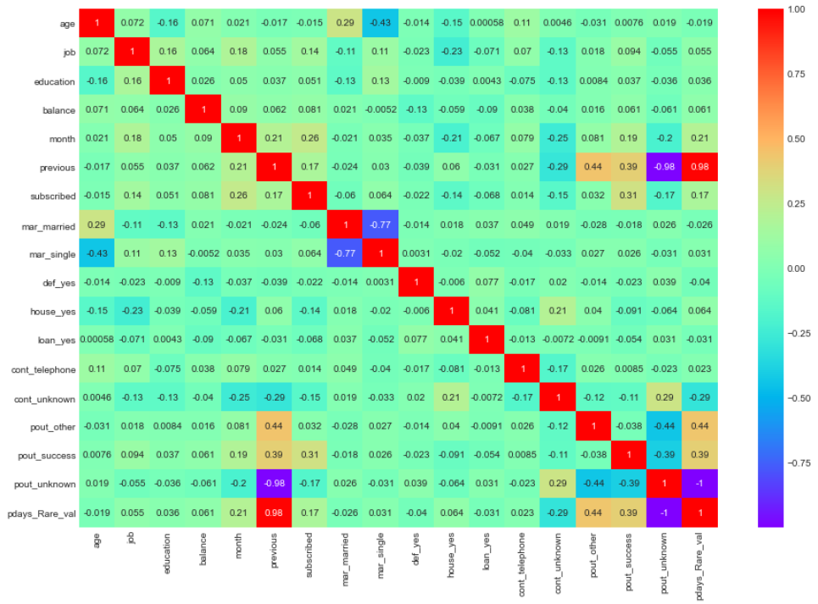
Correlation Heatmap
There are some strong correlations between in our dataset
Pdays_rare_val and ‘previous’ are some of the features showing the strongest correlations

Slide 23
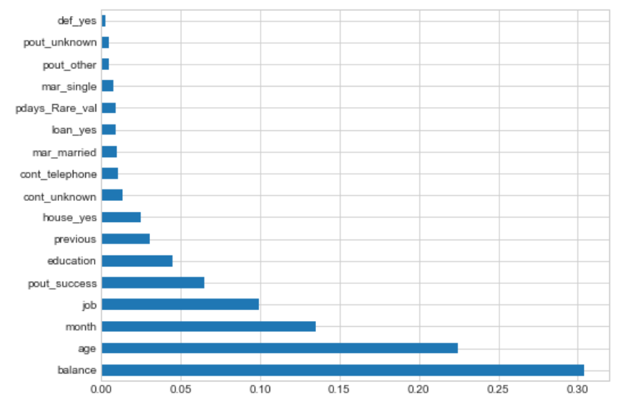
Feature Selection using ExtraTreesClassifier:
Considered the top eight features of our dataset

Slide 24
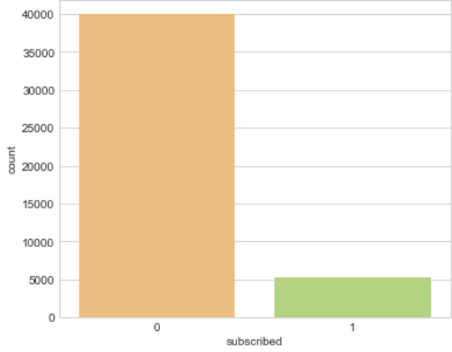
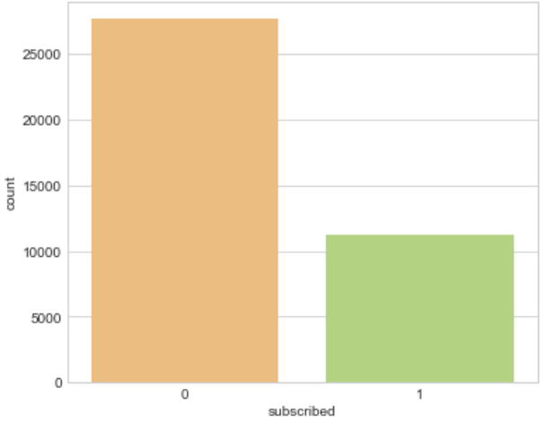
Dealing with class Imbalance using SMOTEENN:
Counts of our class labels initially
Counts of our class labels after applying SMOTEENN

Slide 25
Fitting and Evaluation of our Model
Using Random Forest Classifier
Using K-Nearest Neighbors Classifier
Using Logistic Regression

Slide 26
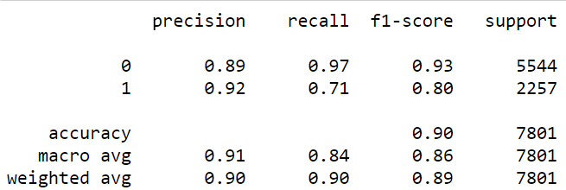
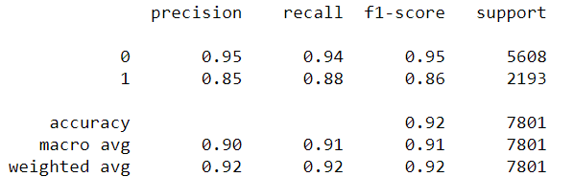
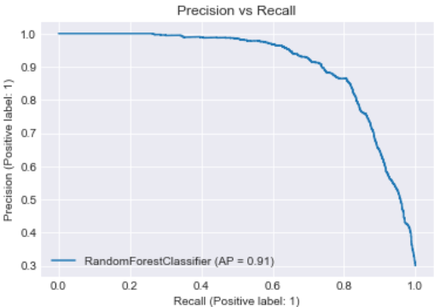
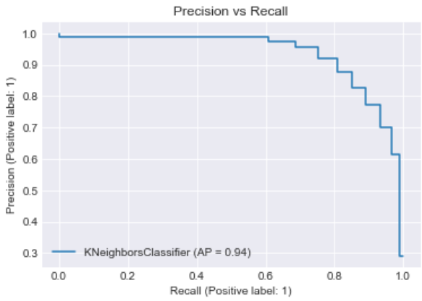
Random forest Classifier
Evaluating our models at default threshold value (0.5)
K-Nearest Neighbors Classifier

Slide 27
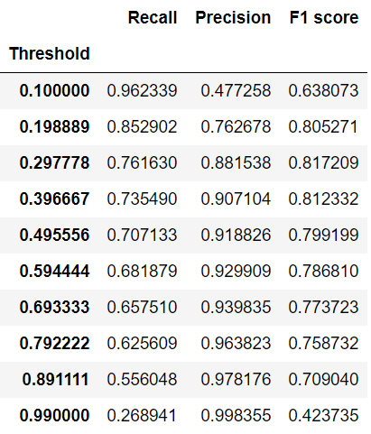
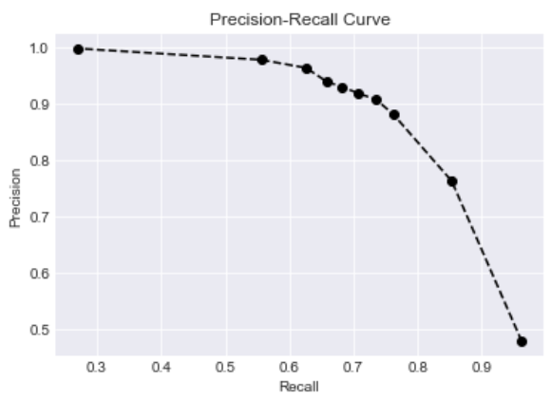
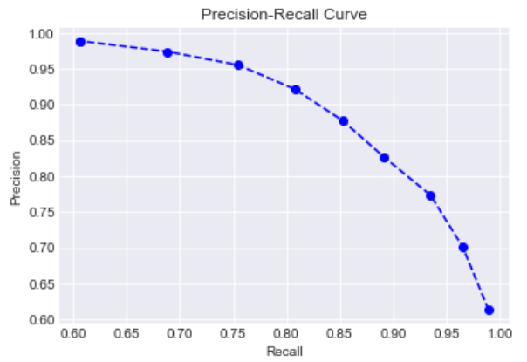
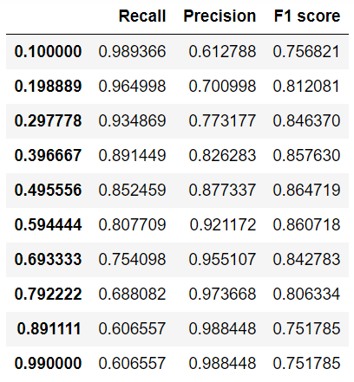
Evaluating our models at different threshold values:
RandomForest Classifier
K-Nearest Neighbors

Slide 28
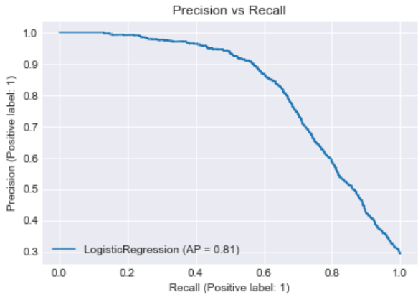
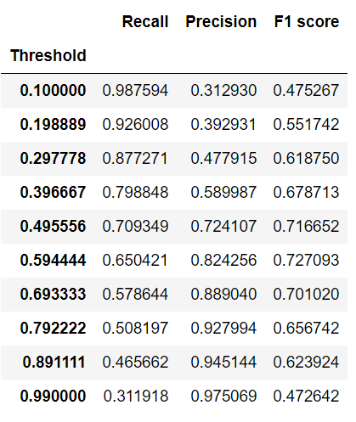
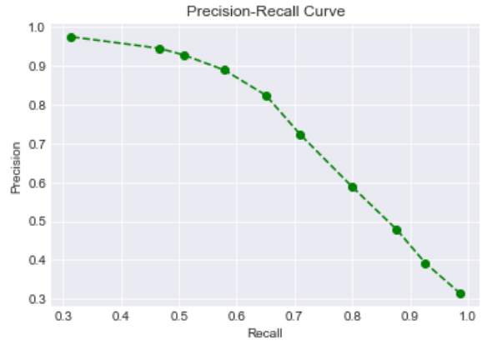
Logistic Regression:

Slide 29
Metrics Discussion
When to prefer Precision over Recall?
Precision should be used when we want to predict the minority class with greater confidence. Suppose the bank wants to reduce the FP such that none of the clients who haven't subscribed to our bank term deposit, should be classified incorrectly. The Bank Manager does not want any clients who haven't subscribed to our plans, take benefits from the bank. In such cases, the threshold is to be increased, such that even if the recall decreases, our model is correctly able to classify the minority class properly.
When to prefer Recall over Precision?
Suppose the bank wants to reduce the FN such that none of the clients who have subscribed to our bank term deposit, be classified incorrectly. The Bank Manager does not want any clients who have subscribed to our plans be misclassified because of which they may not be able to avail our returns on interests even after paying a handsome amount. This may lead to a bad reputation of the bank. In such cases, the threshold is to be decreased, such that even if the precision decreases, our model is correctly able to classify the clients who have subscribed to our plans

Slide 30
Conclusion:
We had a good overall Precision-Recall score at varying thresholds using both RandomForest Classifier and KNN Classifier. Depending on our problem statement, we will be using Recall as our metric.
Interpreting the results from EDA, we found out that the bank had targeted clients mostly from management professionals, blue-collared and administrators. However, we found that the percentage of success of a bank in subscribing a client is much more in students, retired clients and even unemployed clients.
Bank authorities have previously contacted their clients more frequently in the months of May, however the percentage of clients subscribing were much less. The percentage of success was much higher when the clients were last contacted in September, however the counts of calls were much less in September.
Age, Job, Balance, Education and month are some of the most important features in predicting our model

